Slide 1
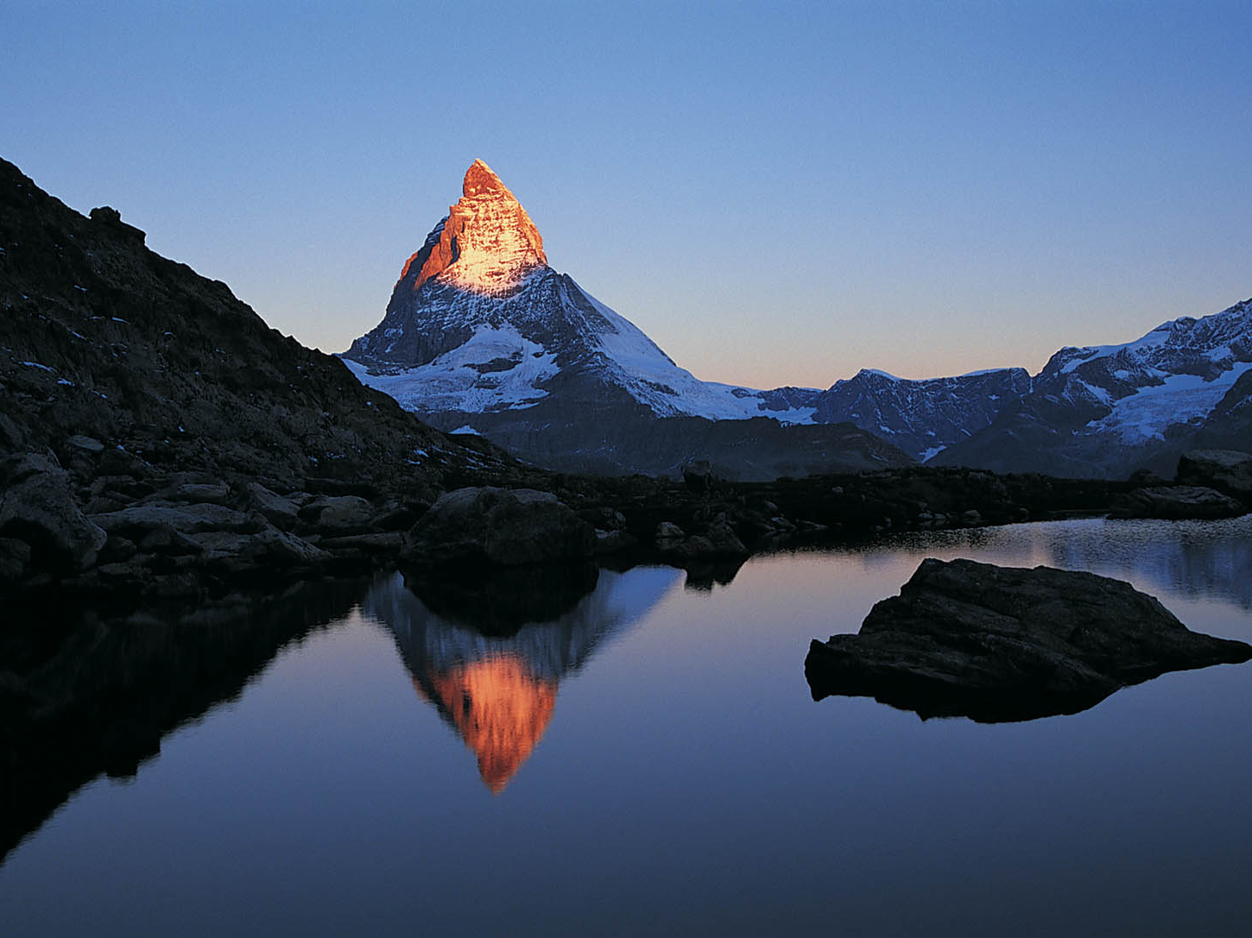
Work
An Invitation to Image God

Slide 2
State of Work
36-64% Would quit their jobs and never work again
17% Would change careers
52% of employees are not engaged at work
19% of employees are actively disengaged

Slide 3
Slothfulness is Sin
Prov 12:24, “The hand of the diligent will rule, while the slothful will be put to forced labor.”
Prov 13:4, “The soul of the sluggard craves and gets nothing, while the soul of the diligent is richly supplied.”
Prov 15:19, “The way of a sluggard is like a hedge of thorns, but the path of the upright is a level highway.”
Prov 19:15 Slothfulness casts into a deep sleep, and an idle person will suffer hunger.

Slide 4
Slothfulness is Sin
Prov 21:25-26 The desire of the sluggard kills him, for his hands refuse to labor. All day long he craves and craves, but the righteous gives and does not hold back.
Prov 24:30-34 I passed by the field of a sluggard, by the vineyard of a man lacking sense, and behold, it was all overgrown with thorns; the ground was covered with nettles, and its stone wall was broken down. Then I saw and considered it; I looked and received instruction. A little sleep, a little slumber, a little folding of the hands to rest, and poverty will come upon you like a robber, and want like an armed man.

Slide 5
Slothfulness is Sin
Ecc 10:18 Through sloth the roof sinks in, and through indolence the house leaks.

Slide 6
Slothfulness is Sin
2 Thess 3:10-12, “If anyone is not willing to work, let him not eat. For we hear that some among you walk in idleness, not busy at work, but busybodies. Now such persons we command and encourage in the Lord Jesus Christ to do their work quietly and to earn their own living.”

Slide 7
What is Work
The need and impulse to work is as much a part of who we are as human beings, as is the impulse and need to love and be loved.

Slide 8
What is Work
Gen 1:26-28: Then God said, “Let us make man in our image, after our likeness. And let them have dominion over the fish of the sea and over the birds of the heavens and over the livestock and over all the earth and over every creeping thing that creeps on the earth.” So God created man in his own image, in the image of God he created him; male and female he created them. And God blessed them. And God said to them, “Be fruitful and multiply and fill the earth and subdue it, and have dominion over the fish of the sea and over the birds of the heavens and over every living thing that moves on the earth.”

Slide 9
What is Work
Gen 2:8,15,18: And the Lord God planted a garden in Eden, in the east, and there he put the man whom he had formed. The Lord God took the man and put him in the garden of Eden to work it and keep it. Then the Lord God said, “It is not good that the man should be alone; I will make him a helper fit for him.”

Slide 10
What is Work
When you feel frustrated, stressed, exhausted, it is never primarily the work’s fault. Whether you are a nurse, student, bank manager, minister, our volunteer. Your bad mood is never primarily the work’s fault.

Slide 11
Forming, Filling, Ruling
Genesis 1:1-5 “In the beginning, God created the heavens and the earth. The earth was without form and void, and darkness was over the face of the deep. And the Spirit of God was hovering over the face of the waters. And God said, “Let there be light,” and there was light. And God saw that the light was good. And God separated the light from the darkness. God called the light Day, and the darkness he called Night. And there was evening and there was morning, the first day.”

Slide 12
Forming, Filling, Ruling
Genesis 2:1-3 “Thus the heavens and the earth were finished, and all the host of them. And on the seventh day God finished his work that he had done, and he rested on the seventh day from all his work that he had done. So God blessed the seventh day and made it holy, because on it God rested from all his work that he had done in creation.”

Slide 13
Forming, Filling, Ruling
The creation account in Genesis is supposed to be, among other things, the foundational story of how and why we work as humans.
I want you my children to continue what I did. Continue to fill this earth, this universe. Continue to shape (subdue, dominate, harness) this earth. Do what I do, work as I work, and then on day seven kick up your feet, and enjoy the fruit of your labor.

Slide 14
Forming, Filling, Ruling
Innovation, invention, improvement, progression, these are desires that flow out of hearts that were created to create
We need to conserve, control, and care for the flourishing of all life on earth
Once we have things we need to keep them in good condition
We were made to rule this earth

Slide 15
Forming, Filling, Ruling
We continue God’s work, we take what he formed, and continue to form it. We take what he filled, and continue to fill it, we take what he rules, and we rule it

Slide 16
Work is Fallen
But, when Adam and Eve our first parents, rebelled against God, it didn’t only affect them it affected all of creation, and every aspect of the way we image God, including work.
We have turned work into something it isn’t suppose to be. An exercise of self interest, not an exercise of selfless worship.

Slide 17
Work is Fallen
Gen 3:17-19 And to Adam (God) said, “Because you have listened to the voice of your wife and have eaten of the tree of which I commanded you, ‘You shall not eat of it,’ cursed is the ground because of you; in pain you shall eat of it all the days of your life; thorns and thistles it shall bring forth for you; and you shall eat the plants of the field. By the sweat of your brow you shall eat bread, till you return to the ground, for out of it you were taken; for you are dust, and to dust you shall return.”

Slide 18
Work is Fallen
Humans are God’s work, and his work rebels against him. And now God has cursed our work so it rebels against us
God will redeem our work, and we know this because God redeemed and reconciled his own work
When Jesus came to redeem the work of God’s hands he did it by a crown of thorns that was placed on his brow, after a night of sweating great drops of blood from his brow

Slide 19
Redemption Work
2 Cor 5:18-21 says, All this is from God, who through Christ reconciled us to himself and gave us the ministry of reconciliation; that is, in Christ God was reconciling the world to himself, not counting their trespasses against them, and entrusting to us the message of reconciliation. Therefore, we are ambassadors for Christ, God making his appeal through us. We implore you on behalf of Christ, be reconciled to God. For our sake he made him to be sin who knew no sin, so that in him we might become the righteousness of God.

Slide 20
Work
An Invitation to Image God

