Slide 1
What’s My Problem
Relationships

Slide 2
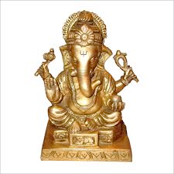
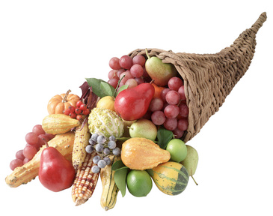

Slide 7
Stop Distracting me

Slide 9
It’s a top level fight
Not a bottom level fight

Slide 10
one reason you were created an individual is so that your strengths could make God’s diverse and interdependent community (church) stronger.
Idolatry causes spiritual suicide, personal shame, spousal separation and brother murder.

Slide 11
Matthew 22:36-40 “Teacher, which is the great commandment in the Law?” And he said to him, “You shall love the Lord your God with all your heart and with all your soul and with all your mind. This is the great and first commandment. And a second is like it: You shall love your neighbor as yourself. On these two commandments depend all the Law and the Prophets.”
1 John 4:19-21 - We love because (God) first loved us. If anyone says, “I love God,” and hates his brother, he is a liar; for he who does not love his brother whom he has seen cannot love God whom he has not seen. And this commandment we have from him: whoever loves God must also love his brother.

Slide 12
Jesus
Our Invisible
Relationship
With God
Our Visible
Relationship
With Others

Slide 13
James 4:1-4 - What causes quarrels and what causes fights among you? Is it not this, that your passions are at war within you? You desire and do not have, so you murder. You covet and cannot obtain, so you fight and quarrel. You do not have, because you do not ask. You ask and do not receive, because you ask wrongly, to spend it on your passions. You adulterous/idolatrous people! Do you not know that friendship with the world is enmity with God?

Slide 14
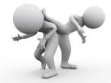
Bad relationships are caused by passions at war with in us, by our unmet desire turning into destroying demand, by enmity with God, by spiritual adultery, a.k.a. rebellion.

Slide 15
Because of sin
five relationship options
hermits
people worshipers
people saviors
puppet masters
sacrificially love people

Slide 16
The Hermit

Slide 17
If your life is filled with a host of terminally casual relationships that are shallow, fun, but more or less temporary you’re a hermit.

Slide 18
- Freedom Idol
The Hermit

Slide 19
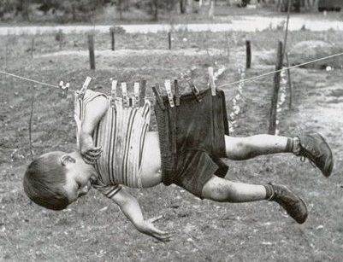
- Freedom Idol
The Hermit

Slide 20
- Freedom Idol
The Hermit

Slide 21
- Freedom Idol
The Hermit

Slide 22
- Freedom Idol
The Hermit

Slide 23
- Freedom Idol
The Hermit

Slide 24
Get deeply connected with a God fearing, God loving, Christ exulting community.

Slide 25
Bad company ruins good morals (1 Cor 15:33)
Unrepentant christians hinder the entire church (Gal 5:9)
Iron sharpens Iron (Prov 27:17)
Build up in love (Eph 4:16)
Pick each other up when they fall (Ecc 4:12)

Slide 26
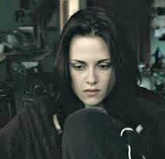
The People Worshiper
Savior

Slide 27
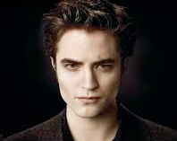
- Boy/girlfriend Idol Idol
The People Worshiper
Savior

Slide 28
- Boy/girlfriend Idol Idol
The People Worshiper
Savior

Slide 29
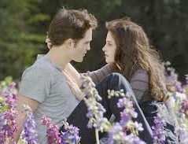
- Boy/girlfriend Idol Idol
The People Worshiper
Savior

Slide 30
- Boy/girlfriend Idol Idol
The People Worshiper
Savior

Slide 31
- Boy/girlfriend Idol Idol
The People Worshiper
Savior

Slide 32
- Boy/girlfriend Idol Idol
The People Worshiper
Savior

Slide 33
The Puppet master

Slide 34
Comfort
The Puppet master

Slide 35
Comfort
The Puppet master

Slide 36
Comfort
A Vacation From Your Problems
The Puppet master

Slide 37
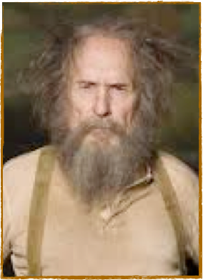
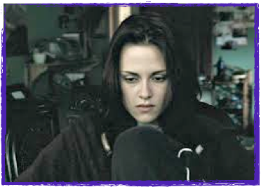
The Puppet master
The Hermit
The People Worshiper
And Savior

Slide 38
Jesus
The Spirit Filled Christian

Slide 39
Jesus
The Spirit Filled Christian

Slide 40
Jesus
It’s a top level fight
The Spirit Filled Christian

